Slide 1
CHAPTER 1
INTRODUCTION AND OVERVIEW

Slide 2
WHAT WILL WE LEARN?
What is image processing?
What are the main applications of image processing?
What is an image?
What is a digital image?
What are the goals of image processing algorithms?
What are the most common image processing operations?
Which hardware and software components are typically needed to build an image processing system?
What is a machine vision system (MVS) and what are its main components?
Why is it so hard to emulate the performance of the human visual system (HVS) using cameras and computers?

Slide 3
Human Activities Covered by Image Processing
Medical Applications
Industrial Applications
Military Applications
Law Enforcement and Security
Consumer Electronics
The Internet, WWW

Slide 4
What is an Image?
An image is a visual usually 2-D representation of an object, a person, or a scene produced by an optical device such as a mirror, a lens, or a camera...

Slide 5
What Is a Digital Image?
A digital image is a representation of a 2D image using a finite number of points, referred to as picture elements, pels, or pixels, with a finite number of colors!

Slide 6
What Is Digital Image Processing?
Science of modifying digital images by means of a digital computer...
Images are changed automatically according to an algorithm as opposed to image manipulation using tools like Photoshop, GIMP, etc.

Slide 7
What Is the Scope of Image Processing?
Low Level
Primitive operations (e.g., noise reduction, contrast enhancement,etc.) where both the input and the output are images
Mid Level
Extraction of attributes (e.g., edges, contours, regions, etc.) from images
High Level
Analysis and interpretation of the contents of a scene

Slide 8
Contributing and Overlapping Areas
Mathematics, physics, computer science, computer, optical, and electrical engineering
Pattern recognition, machine learning, artificial intelligence, and human vision research...

Slide 9
Typical Image Processing Operations
Sharpening
Noise Removal
Deblurring
Edge Extraction
Binarization
Blurring
Contrast Enhancement
Object Segmentation and Labeling

Slide 10
Sharpening

Slide 11
Noise Removal

Slide 12
Deblurring

Slide 13
Edge Extraction

Slide 14
Binarization

Slide 15
Blurring

Slide 16
Contrast Enhancement

Slide 17
Object Segmentation and Labeling

Slide 18
Components of a Digital Image Processing System

Slide 19
Machine Visual System
Sequential processing scheme of a license plate recognition system

Slide 20
Human Visual System
It is extremely difficult to emulate the performance of the human visual system - in terms of processing speed, previously acquired knowledge, and the ability to resolve visual scenes under a wide range of conditions - using machine vision systems.

Slide 21
MVS vs. HVS
Why is it so hard to emulate the performance of the human visual system (HVS) using cameras and computers?
Very large database of images and associated concepts
Very high speed
Ability to work under a wide range of conditions
Most MVS must impose numerous constraints on the operating conditions of the scene to improve their chances of success.

Slide 22
Easy vs Hard Problems
While a computer would have a hard time identifying this as a bolt, it could easily count how many threads per inch there are :)

Slide 23
Easy vs Hard Problems
Easy | Hard
How wide is this plate? Is it dirty? | Look at a picture of a random kitchen, and find all the dirty plates.
Did something change between these two images? | Track an object or person moving through a crowded room of other people.
Measure the diameter of a wheel. Check to see if it is bent. | Identify arbitrary parts on pictures of bicycles.
What color is this leaf? | What kind of leaf is this?

Slide 24
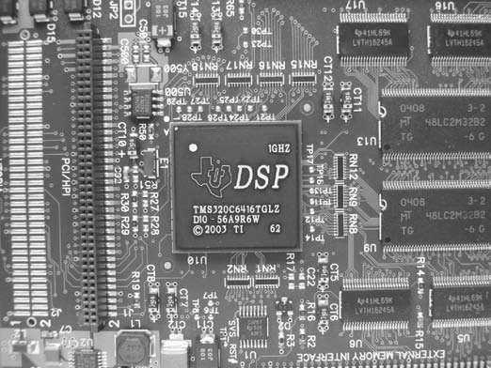
PROBLEMS
Prb1: Design a machine vision system to read the label of the main integrated circuit (IC). Explain what each block will do, their input and output, what are the most challenging requirements, and how they will be met by the designed solution.

Slide 25
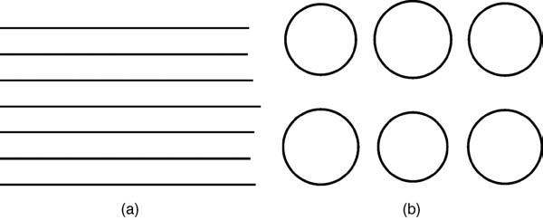
PROBLEMS
Prb2: Who do you think would perform better at the following tasks- man (HVS) or computer (MVS) and why? a) Determining which line is the shortest b) Determining which circle is the smallest

Slide 26
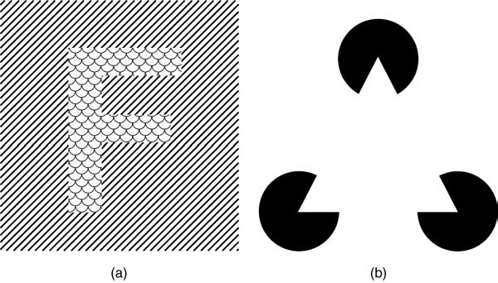
PROBLEMS
Who do you think would perform better at the following tasks: man (HVS) or computer (MVS) and why? a) Segmenting the image containing the letter “F” from the background b) Segmenting the white triang

Slide 27
Topics for Assignment

Slide 28
References
Practical Image and Video Processing using Matlab, Oge Marques, 2011, Chapter 1

